Slide 1

A Path to Improve Customer Service
May 2024

Slide 2
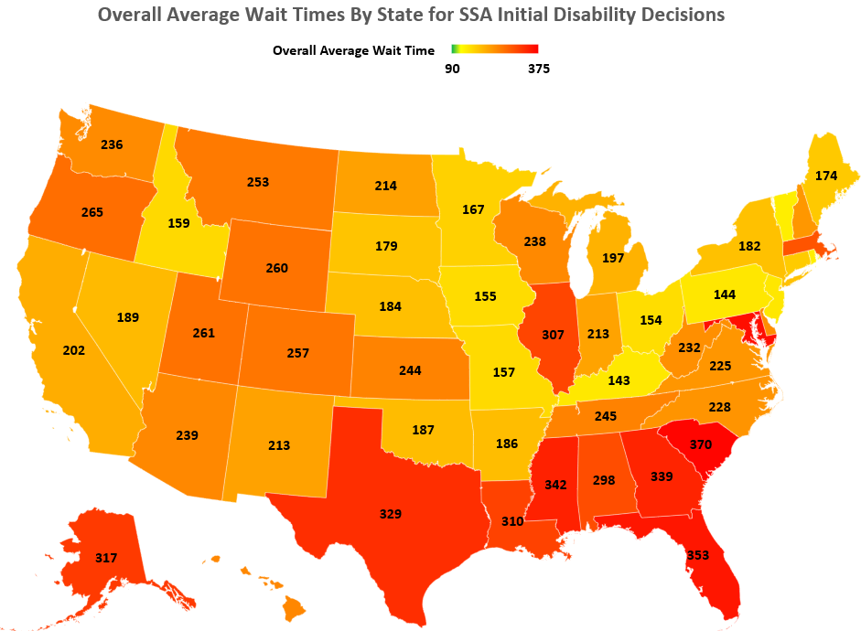
Overall Average Wait Time By State for SSA Initial Disability Decisions
* Average wait times in days; updated as of Friday, May 31, 2024
** Map color gradation is based on SSA’s historical overall average wait time of 120 days for initial disability claims
Data Source: Social Security Administration
Notes:
Overall Average Wait Times by State for SSA Initial Disability Decisions
United States map showing data for the overall average wait times, by State, for SSA initial disability decisions.
Footer:
Average wait times in days; updated as of Friday, May 31, 2024
Data Source:
Social Security Administration
Map Data:
US Map showing data of average wait time in days, based on SSA’s historical overall average wait time of 120 days for initial disability claims in color graduation: light yellow up to 150 days, yellow up to 180 days, dark yellow up to 210 days, light orange up to 240 days, orange up to 270-days, dark orange up to 300 days, light red more than 300 days.
Shortest average wait time: Puerto Rico, 133 days
Longest average wait time: South Carolina, 370 days
Wait times for states in the light-yellow range:
Puerto Rico, 133 days
Rhode Island, 137 days
Vermont, 137 days
Kentucky, 143 days
New Jersey, 144 days
Pennsylvania, 144 days
Wait times for states in the yellow range:
Iowa, 155 days
Ohio, 154 days
Missouri, 157 days
Idaho, 159 days
Minnesota, 167 days
Maine, 174 days
Connecticut, 172 days
South Dakota, 179 days
Wait times for states in the dark yellow range:
Arkansas, 186 days
Oklahoma, 187 days
New York, 182 days
Nebraska, 184 days
Nevada, 189 days
California, 202 days
Michigan, 197 days
Indiana, 213 days
Wait times for states in the light orange range:
North Dakota, 214 days
New Mexico, 213 days
Washington D.C., 221 days
Virginia, 228 days
West Virginia, 232 days
North Carolina, 228 days
Washington, 236 days
New Hampshire, 224 days
Delaware, 234 days
Arizona, 239 days
Wait times for states in the orange range
Kansas, 244 days
Wisconsin, 234 days
Hawaii, 240 days
Tennessee, 245 days
Wyoming, 260 days
Utah, 261 days
Montana, 253 days
Colorado, 257 days
Oregon, 265 days
Wait times for states in the dark orange range
Massachusetts, 291 days
Alabama, 298 days
Wait times for states in the light red range
Louisiana, 310 days
Illinois, 307 days
Alaska, 317 days
Texas, 329 days
Georgia, 339 days
Mississippi, 342 days
Florida, 353
Maryland, 361
South Carolina, 370

Slide 3
Staffing Declines as Beneficiaries Rise
Field Office Attrition 10% 1-800 Staff Attrition 22%
Notes:
Staffing Declines as Beneficiaries Rise
Combination Chart – Line and Bar Graph comparison between steady rise of beneficiaries and the fluctuating and declining staffing.
Footer:
Field office attrition 10%. 1-800 staff attrition 22%
Chart data:
x-axis – Fiscal Year (FY) 1999 through FY 2024 – Fiscal Year 2024 is estimated
y-axis 1 – Bar Graph, Beneficiaries and Recipients in Millions. Bars have three sections 1 – Old-Age and Survivors Insurance (OASI) Beneficiaries, 2 – Disability Insurance (DI) Beneficiaries, 3 – Supplement Security Income (SSI) Recipients.
Total values for the three categories show a steady rise for the covered timeframe –
51 million in FY 1999
59 million in FY 2009
71 million in FY 2019, and
an estimated rise to 75 million in FY 2024.
OASI beneficiaries’ data shows the largest rise from 37 million in FY 1999, to an estimated 59 million in 2024.
DI beneficiaries’ numbers have risen slightly, with a steady increase from 7 million in FY 1999 to approx. 11 million in FY 2017, beginning a slight decline to an estimated 8 million in 2024.
SSI recipients in FY 1999 were approx. 7 million. This number has been constant, with a slight increase to 10 million between FY 2009 and FY2021, beginning in 2023 there is a slight decline to an estimated 7 million in 2024.
y-axis 2– Line graph, Agency full-time permanent employees (excluding State DDS staff)- in thousands.
Numbers for employees have fluctuated, with the second highest number in FY 2005 – 63,064, highest number in FY 2010 – 66,967, and third highest number in FY 2015 – 62,948
In FY 2022 Staffing levels were the lowest in 25 years – at 56, 423
Staffing levels in comparison to OASI beneficiaries, DI beneficiaries and SSI recipients for all listed fiscal years:
FY 1999 - 59,293 employees, compared to 51 million OASI beneficiaries, DI beneficiaries and SSI recipients.
FY 2000 - 59,442 employees compared to 51 million beneficiaries and recipients.
FY 2001 - 60,568 employees compared to 52 million beneficiaries and recipients.
FY 2002 - 61,058 employees compared to 53 million beneficiaries and recipients.
FY 2003 - 62,702 employees compared to 53 million beneficiaries and recipients.
FY 2004 - 62,288 employees compared to 54 million beneficiaries and recipients.
FY 2005 - 63,064 employees compared to 55 million beneficiaries and recipients.
FY 2006 - 61,068 employees compared to 56 million beneficiaries and recipients.
FY 2007 - 59,623 employees compared to 57 million beneficiaries and recipients.
FY 2008 - 61,352 employees compared to 58 million beneficiaries and recipients.
FY 2009 - 64,621 employees compared to 59 million beneficiaries and recipients.
FY 2010 - 66,967 employees compared to 61 million beneficiaries and recipients.
FY 2011 - 64,176 employees compared to 62 million beneficiaries and recipients.
FY 2012 - 62,382 employees compared to 64 million beneficiaries and recipients.
FY 2013 - 59,276 employees compared to 65 million beneficiaries and recipients.
FY 2014 - 62,424 employees compared to 67 million beneficiaries and recipients.
FY 2015 - 62,948 employees compared to 68 million beneficiaries and recipients.
FY 2016 - 62,173 employees compared to 69 million beneficiaries and recipients.
FY 2017 - 60,744 employees compared to 69 million beneficiaries and recipients.
FY 2018 - 60,519 employees compared to 70 million beneficiaries and recipients.
FY 2019 - 59,946 employees compared to 71 million beneficiaries and recipients.
FY 2020 - 59,848 employees compared to 72 million beneficiaries and recipients.
FY 2021 - 58,469 employees compared to 73 million beneficiaries and recipients.
FY 2022 - 56,423 employees compared to 73 million beneficiaries and recipients.
FY 2023 - 59,514 employees compared to 74 million beneficiaries and recipients.
FY 2024 there will be an estimated 56,894 employees compared to 75 million beneficiaries and recipients.

Slide 4
Administrative Funding Declining as % of Benefit Outlays
Notes:
SSA Limitations on Administrative Expense (LAE) as a Percent of Benefit Outlays
Notes: Beneficiaries are rising. 12,000 more retirees each week – record high. Staffing levels are declining to lowest level in 27 years. This has resulted in a customer service crisis and declines in our performance.
Combination Chart – Line and Bar Graph comparison between Benefit Payment Outlays to Administrative Expense (LAE) in percent of benefit outlays
Legend: Bar graph Benefit payment outlays, Line graph: Actual percent of LAE to Benefit Payments
Chart data:
x-axis – Fiscal Year (FY) 15, actual, through FY 24 – enacted
y-axis – Bar Graph, Benefit Payment Outlays in $ millions
y-axis – Line Graph, LAE in percent of benefit outlays
Highest LAE was 1.26% in FY 2015, 2016 and 2017.
Lowest LAE was 0.95% in FY 2024.
Limitation on Administration Expense (LAE) in comparison to the benefit payments outlays for all listed years
FY 2015 – LAE was 1.26% in comparison to the benefit payments outlays of $933,841
FY 2016 – LAE was 1.26% in comparison to the benefit payments outlays of $966,828
FY 2017 – LAE was 1.26% in comparison to the benefit payments outlays of $991,115
FY 2018 – LAE was 1.25% in comparison to the benefit payments outlays of $1,029,881
FY 2019 – LAE was 1.18% in comparison to the benefit payments outlays of $1,091,345
FY 2020 – LAE was 1.13% in comparison to the benefit payments outlays of $1,143,115
FY 2021 – LAE was 1.09% in comparison to the benefit payments outlays of $1,181,218
FY 2022 – LAE was 1.05% in comparison to the benefit payments outlays of $1,269,959
FY 2023 – LAE was 1.01% in comparison to the benefit payments outlays of $1,404,723
In FY 2024 the estimated LAE is 1.02% in comparison to the benefit payments outlays of $1,512,807
Map of the United States Social Security Administration Regions

Slide 5



We are still far more efficient than private insurance companies in admin expenses

Slide 6
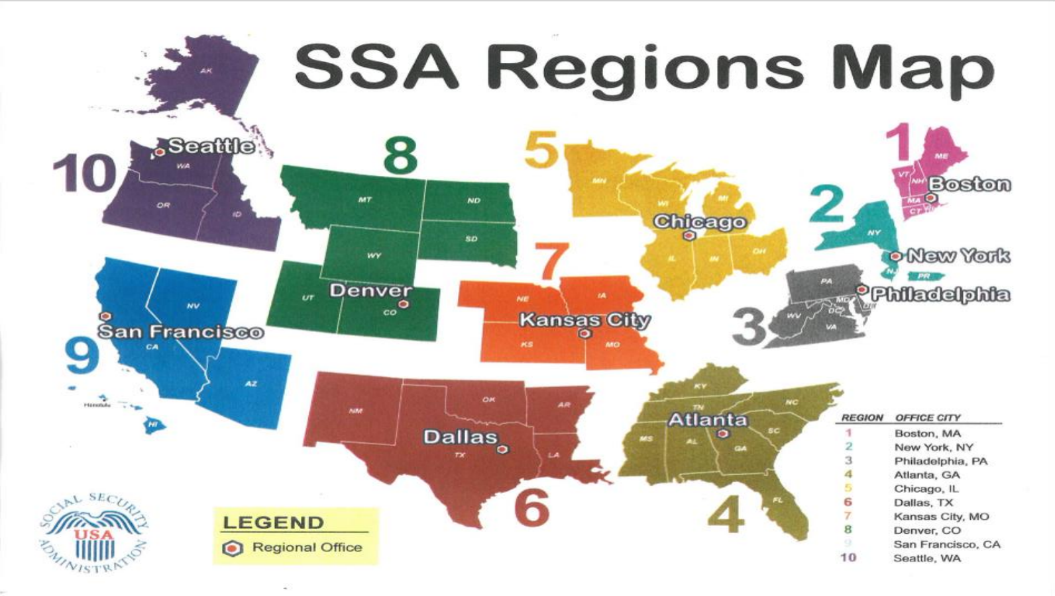

Driving Change, Leading from the Front Lines
Announced a plan to increase our onsite presence beginning
in April.
Hired new Chief Operating Officer, Chief Information Officer,
and General Counsel.
Conducted 10 town halls throughout the country; over 2,000
employees present.
Launched SecuritySTAT on February 5 – a cross-cutting performance management program – to
accelerate the deployment of a host of customer service improvements.

Slide 7
The President’s Budget Improves Customer Service
Field Office Attrition 10% 1-800 Staff Attrition 22%
*Estimate consistent with the FY 2025 President’s Budget Request
Notes:
The President’s Budget Improves Customer Service
Combination Chart – Line and Bar Graph comparison between steady rise of beneficiaries and the fluctuating and declining staffing. There is an estimated increase by FY 2025 in staffing consistent with the President’s Budget Request for that Fiscal Year.
Footer:
Field office attrition 10%. 1-800 staff attrition 22%
Chart data:
x-axis – Fiscal Year (FY) 1999 through FY 2029 – FY 2024 through FY2029 are estimates
y-axis 1 – Bar Graph, Beneficiaries and Recipients in Millions. Bars have three sections 1 – Old-Age and Survivors Insurance (OASI) Beneficiaries, 2 – Disability Insurance (DI) Beneficiaries, 3 – Supplement Security Income (SSI) Recipients.
Total values for the three categories show a steady rise for the covered timeframe – from 51 million in FY 1999 estimated to be 83 million by FY 2029.
OASI beneficiaries’ data shows the largest rise from 37 million in FY 1999, to an estimated 65 million by 2029.
DI beneficiaries’ numbers have risen slightly, with a steady increase from 7 million in FY 1999 to approx. 11 million in FY 2017, beginning a slow decline to an estimated 9 million by 2029.
SSI recipients in FY 1999 were approx. 7 million. This number has been constant, with a slight increase to 10 million between FY 2009 and FY2021, estimated to decline to 8 million by 2029.
y-axis 2– Line graph, Agency full-time permanent employees (excluding State DDS staff)- in thousands.
Numbers for employees have fluctuated, with the second highest number in FY 2005 – 63,064, highest number in FY 2010 – 66,967, and third highest number in FY 2015 – 62,948
In FY 2022 staffing levels were the lowest in 25 years – at 56, 423
In FY 2024 the estimated staffing level is 56,894 employees
The FY 2025 estimate, consistent with the FY 2025 President’s Budget Request, is 60, 097 full-time permanent employees.
Staffing levels in comparison to OASI beneficiaries, DI beneficiaries and SSI recipients for all listed fiscal years:
FY 1999 - 59,293 employees, compared to 51 million OASI beneficiaries, DI beneficiaries and SSI recipients.
FY 2000 - 59,442 employees compared to 51 million beneficiaries and recipients.
FY 2001 - 60,568 employees compared to 52 million beneficiaries and recipients.
FY 2002 - 61,058 employees compared to 53 million beneficiaries and recipients.
FY 2003 - 62,702 employees compared to 53 million beneficiaries and recipients.
FY 2004 - 62,288 employees compared to 54 million beneficiaries and recipients.
FY 2005 - 63,064 employees compared to 55 million beneficiaries and recipients.
FY 2006 - 61,068 employees compared to 56 million beneficiaries and recipients.
FY 2007 - 59,623 employees compared to 57 million beneficiaries and recipients.
FY 2008 - 61,352 employees compared to 58 million beneficiaries and recipients.
FY 2009 - 64,621 employees compared to 59 million beneficiaries and recipients.
FY 2010 - 66,967 employees compared to 61 million beneficiaries and recipients.
FY 2011 - 64,176 employees compared to 62 million beneficiaries and recipients.
FY 2012 - 62,382 employees compared to 64 million beneficiaries and recipients.
FY 2013 - 59,276 employees compared to 65 million beneficiaries and recipients.
FY 2014 - 62,424 employees compared to 67 million beneficiaries and recipients.
FY 2015 - 62,948 employees compared to 68 million beneficiaries and recipients.
FY 2016 - 62,173 employees compared to 69 million beneficiaries and recipients.
FY 2017 - 60,744 employees compared to 69 million beneficiaries and recipients.
FY 2018 - 60,519 employees compared to 70 million beneficiaries and recipients.
FY 2019 - 59,946 employees compared to 71 million beneficiaries and recipients.
FY 2020 - 59,848 employees compared to 72 million beneficiaries and recipients.
FY 2021 - 58,469 employees compared to 73 million beneficiaries and recipients.
FY 2022 - 56,423 employees compared to 73 million beneficiaries and recipients.
FY 2023 - 59,514 employees compared to 74 million beneficiaries and recipients.
FY 2024 there will be an estimated 56,894 employees compared to 75 million beneficiaries and recipients.
The FY 2025 agency full-time employee is estimated to be 60,097,consistent with the FY 2025 President’s Budget Request.

